Slide 1
https://devblogs.microsoft.com/dotnet/announcing-net-6/
https://learn.microsoft.com/en-us/training/modules/persist-data-ef-core/3-migrations

Slide 2
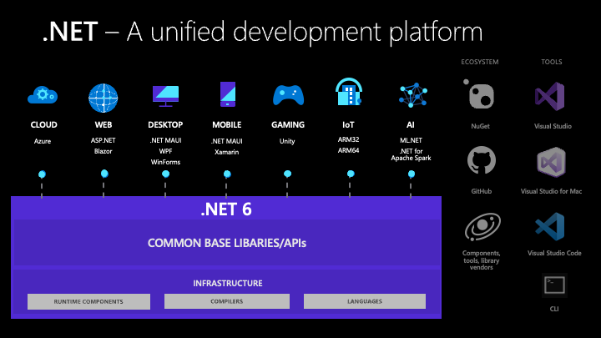
Unified and extended platform
.NET 6 delivers a unified platform, for browser, cloud, desktop, IoT, and mobile apps. The underlying platform has been updated to serve the needs of all app types and to make it easy to re-use code across all your apps. New capabilities and improvements are available to all apps at the same time, so that your code running in the cloud or on a mobile device behaves the same way and has the same benefits.

Slide 3
The reach of .NET developers continues to widen with each release. Machine learning and WebAssembly are two of the most recent additions. For example, with machine learning, you can write apps that look for anomalies in streaming data. With WebAssembly, you can host .NET apps in the browser, just like HTML and JavaScript, or mix them with HTML and JavaScript.
One of the most exciting additions is .NET Multi-platform App UI (.NET MAUI). You can now write code — in a single project — that delivers a modern client app experience across desktop and mobile operating systems. .NET MAUI will be released a little later than .NET 6. We’ve put a lot of time and effort into .NET MAUI and are very excited to release it and see .NET MAUI apps in production.
Of course, .NET apps are also at home on Windows desktop — with Windows Forms and WPF — and in the cloud with ASP.NET Core. They are the app types we’ve offered for the longest and they continue to be very popular, and we’ve improved them in .NET 6.

Slide 4
Cloud diagnostics have been improved with OpenTelemetry and dotnet monitor, which is now supported in production and available with Azure App Service.
JSON APIs are more capable and have higher performance with a source generator for the serializer.
Minimal APIs introduced in ASP.NET Core to simplify the getting started experience and improve the performance of HTTP services.
Blazor components can now be rendered from JavaScript and integrated with existing JavaScript based apps.
WebAssembly AOT compilation for Blazor WebAssembly (Wasm) apps, as well as support for runtime relinking and native dependencies.
Single-page apps built with ASP.NET Core now use a more flexible pattern that can be used with Angular, React, and other popular frontend JavaScript frameworks.
HTTP/3 has been added so that ASP.NET Core, HttpClient, and gRPC can all interact with HTTP/3 clients and servers.
File IO now has support for symbolic links and has greatly improved performance with a re-written-from-scratch FileStream.
Security has been improved with support for OpenSSL 3, the ChaCha20Poly1305 encryption scheme, and runtime defense-in-depth mitigations, specifically W^X and CET.
Single-file apps (extraction-free) can be published for Linux, macOS, and Windows (previously only Linux).
IL trimming is now more capable and effective, with new warnings and analyzers to ensure correct final results.
Source generators and analyzers have been added that help you produce better, safer, and higher performance code.
Source build enables organizations like Red Hat to build .NET from source and offer their own builds to their users.
.NET 6 Highlights
.NET 6 is:
Production stress-tested with Microsoft services, cloud apps run by other companies, and open source projects.
Supported for three years as the latest long term support (LTS) release.
Unified platform across browser, cloud, desktop, IoT, and mobile apps, all using the same .NET Libraries and the ability to share code easily.
Performance is greatly improved across the board and for file I/O in particular, which together result in decreased execution time, latency, and memory use.
C# 10 offers language improvements such as record structs, implicit using, and new lambda capabilities, while the compiler adds incremental source generators. F# 6 adds new features including Task based async, pipeline debugging and numerous performance improvements.
Visual Basic has improvements in the Visual Studio experience and for Windows Forms project open experience.
Hot Reload enables you to skip rebuilding and restarting your app to view a new change — while your app is running — supported in Visual Studio 2022 and from the .NET CLI, for C# and Visual Basic.

Slide 5
Global and implicit usings
using directives simplify how you work with namespaces. C# 10 includes a new global using directive and implicit usings to reduce the number of usings you need to specify at the top of each file.
Global using directives
If the keyword global appears prior to a using directive, that using applies to the entire project:
global using System;
You can use any feature of using within a global using directive. For example, adding static imports a type and makes the type’s members and nested types available throughout your project. If you use an alias in your using directive, that alias will also affect your entire project:
global using static System.Console; global using Env = System.Environment;
You can put global usings in any .cs file, including Program.cs or a specifically named file like globalusings.cs. The scope of global usings is the current compilation, which generally corresponds to the current project.
Global using directives
Global using directives let you specify a using directive just once and have it applied to every file that you compile.
The following examples show the breadth of the syntax:
global using System;
global using static System.Console;
global using Env = System.Environment;
You can put global using statements in any .cs file, including in Program.cs.
Implicit usings is an MSBuild concept that automatically adds a set of global using directives depending on the SDK. For example, console app implicit usings differ from ASP.NET Core.
Implicit usings are opt-in, and enabled in a PropertyGroup:
<ImplicitUsings>enable</ImplicitUsings>
Implicit usings are opt-in for existing projects but included by default for new C# projects

Slide 6
File-scoped namespaces
Many files contain code for a single namespace. Starting in C# 10, you can include a namespace as a statement, followed by a semi-colon and without the curly brackets:
namespace MyCompany.MyNamespace;
class MyClass // Note: no indentation
{ ... }
This simplifies the code and removes a level of nesting. Only one file-scoped namespace declaration is allowed, and it must come before any types are declared.

Slide 7
dotnet-apphost-pack-6.0 - Microsoft.NETCore.App.Host 6.0.7.NET is a development platform that you can use to build command-line applications, microservices and modern websites. It is open source, cross-platform and is supported by Microsoft.

Slide 8
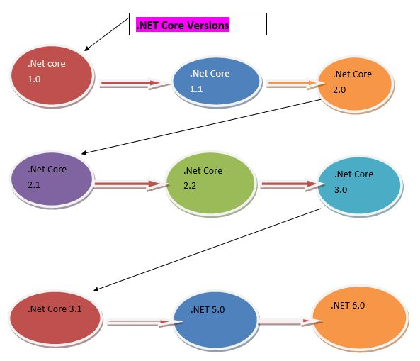
What is .NET Core?
.NET Core is a new version of .Net framework, developed by Microsoft. It is an open-source framework for developing windows, web applications, services, and mobile applications and it can be run on Windows, Mac, or Linux. .Net Core application can run on both .NET CORE and traditional .NET Framework (.NET framework 4.x). It is completely rewritten from scratch and it was initially launched as .Net 5 but then it was renamed to .NET CORE 1.0.
In simple words, .Net Core is a Cross platform, High-performance, unified, fast, lightweight, Open-source framework for building modern, Mobile, web, windows applications and services.
.NET Core Versions

Slide 9
History of .NET Core Versions
The below table shows the details of .Net Core Versions.
Version | Release Date | Development/Editor Tool | Support
.Net Core 1.0 | Jun-27-2016 | Visual Studio 2015 updated version 3 | 1.0
.Net Core 1.1 | Nov-18-2016 | Visual Studio 2015,2017 | 1.0,1.1
.Net Core 2.0 | Aug-14-2017 | Visual Studio 2017 Version 15.3 | 1.0,1.1,2.0
.Net Core 2.1 Long Term Support | May-30-2018 | Visual Studio 2017 Version 15.7 | 1.0,1.1,2.0,2.1
.Net Core 2.2 | Dec-04-2018 | Visual Studio 2017 Version15.9 | 1.0,1.1,2.0,2.1,2.2
.Net Core 3.0 | Sep-23-2019 | Visual Studio 2019 Version 16.3 | 1.0,1.1,2.0,2.1,2.2,3.0
.Net Core 3.1 (3 yr Long-term support) | Dec-03-2019 | Visual Studio 2019 Version 16.4 | 1.0,1.1,2.0,2.1,2.2,3.0, 3.1
.NET 5.0 | Nov-10-2020 | Visual Studio 2019 Version 16.8 | 1.0,1.1,2.0,2.1,2.2,3.0, 3.1,5.0
.NET 6.0 1 (3 yr Long-term support) | Nov-08-2021 | Visual Studio 2022 Version 17.0 | 6.0
.NET 7.0 | 2022-11(projected) |  | -
.NET 8.0 | 2023-11(projected) |  | -

Slide 10
Why Use .Net Core?
Cross platform - It can run on Windows, Linux and Mac.
Unified - It offers a single unified component like .NET Standard library for all platforms with the same code, same languages, and same tools.
Better performance - .Net core does not depend on system.web.dll for communication between Browser-server. In .Net core everything is packages which we need for our application. Packages reduce the request pipeline and improve the application performance.
Lightweight - It is a lightweight framework. It allows developers to deploy libraries and components that are needed in a set of packages.
Dependency Injection - Dependency Injection is in-built in .Net Core.
Hosting - .Net Core application can be hosted on multiple Web server such as IIS, Apache, Docker, etc. It is not dependent on IIS.
Open Source - It is a fully open-source framework. That means, it is free of cost and its source code is available.
Testability - Unit testing is very easy in .Net core application.
Side-by-side App Versioning - .Net Core runs on .NET Core, which supports simultaneously running in multiple versions of applications.

Slide 11
Why .NET Core?
There are some limitations with the .NET Framework. For example, it only runs on the Windows platform. Also, you need to use different .NET APIs for different Windows devices such as Windows Desktop, Windows Store, Windows Phone, and Web applications. In addition to this, the .NET Framework is a machine-wide framework. Any changes made to it affect all applications taking a dependency on it.
Today, it's common to have an application that runs across devices; a backend on the web server, admin front-end on windows desktop, web, and mobile apps for consumers. So, there is a need for a single framework that works everywhere. So, considering this, Microsoft created .NET Core. The main objective of .NET Core is to make .NET Framework open-source, cross-platform compatible that can be used in a wide variety of verticals, from the data center to touch-based devices.

Slide 12

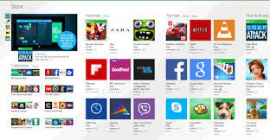

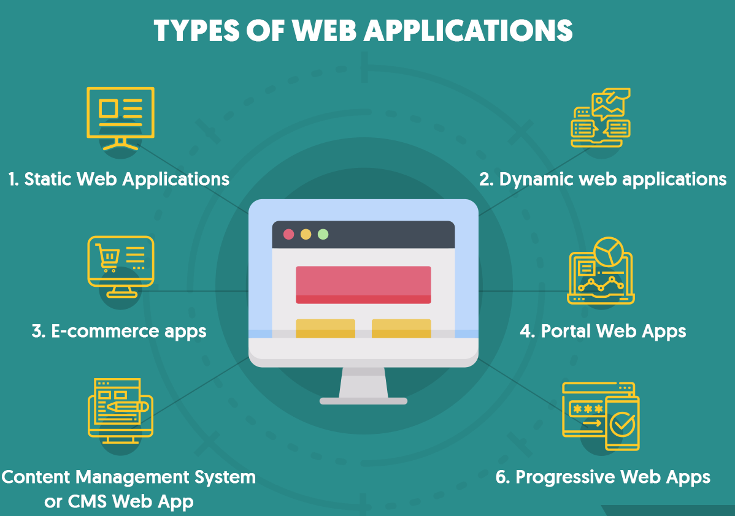
NET Framework. For example, it only runs on the Windows platform. Also, you need to use different .NET APIs for different Windows devices such as Windows Desktop, Windows Store, Windows Phone, and Web applications. In addition to this, the .NET Framework is a machine-wide framework.
Windows Desktop, Windows Store, Windows Phone, and
Web applications

Slide 13
NET Core Characteristics
Open-source Framework: .NET Core is an open-source framework maintained by Microsoft and available on GitHub under MIT and Apache 2 licenses. It is a .NET Foundation project.
You can view, download, or contribute to the source code using the following GitHub repositories:
Language compiler platform Roslyn: https://github.com/dotnet/roslyn
.NET Core runtime: https://github.com/dotnet/runtime
.NET Core SDK repository. https://github.com/dotnet/sdk
ASP.NET Core repository. https://github.com/dotnet/aspnetcore
Cross-platform: .NET Core runs on Windows, macOS, and Linux operating systems. There are different runtime for each operating system that executes the code and generates the same output.
Consistent across Architectures: Execute the code with the same behavior in different instruction set architectures, including x64, x86, and ARM.
Wide-range of Applications: Various types of applications can be developed and run on .NET Core platform such as mobile, desktop, web, cloud, IoT, machine learning, microservices, game, etc.
Supports Multiple Languages: You can use C#, F#, and Visual Basic programming languages to develop .NET Core applications. You can use your favorite IDE, including Visual Studio 2017/2019, Visual Studio Code, Sublime Text, Vim, etc.
Modular Architecture: .NET Core supports modular architecture approach using NuGet packages. There are different NuGet packages for various features that can be added to the .NET Core project as needed. Even the .NET Core library is provided as a NuGet package. The NuGet package for the default .NET Core application model is Microsoft.NETCore.App.
This way, it reduces the memory footprint, speeds up the performance, and easy to maintain.
CLI Tools: .NET Core includes CLI tools (Command-line interface) for development and continuous-integration.
Flexible Deployment: .NET Core application can be deployed user-wide or system-wide or with Docker Containers.
Compatibility: Compatible with .NET Framework and Mono APIs by using .NET Standard specification.

Slide 14
Version | Latest Version | Visual Studio | Release Date | End of Support
.NET 5 | Preview 1 | VS 2019 | 16th March, 2020
.NET Core 3.x - latest | 3.1.3 | VS 209 | 24th March, 2020 | 12th March, 2022
.NET Core 2.x | 2.1.17 | VS 2017, 2019 | 24th March, 2020 | 21st August, 2021
.NET Core 1.x | 1.1.13 | VS 2017 | 14th May, 2019 | 27th May, 2019
Both, .NET 3.1, and .NET Core 2.1 will have long term support.
.NET Core 3.x applications only run on .NET Core Framework.
.NET Core 2.x applications run on .NET Core as well as .NET Framework.

Slide 15
NET Core Composition
The .NET Core Framework composed of the following parts:
.NET Core
CLI Tools: A set of tooling for development and deployment.
Roslyn: Language compiler for C# and Visual Basic
CoreFX: Set of framework libraries.
CoreCLR: A JIT based CLR (Command Language Runtime).
.netCore
What does .NET Core consists of?
Which is the main component of .NET Core composition?
The two main components of . NET are
CoreCLR and CoreFX, which are comparable to the Common Language Runtime (CLR) and
the Framework Class Library (FCL) of the . NET Framework's Common Language Infrastructure (CLI) implementation.
CLI Tool
Roslyn
CoreFX
CoreCLR

Slide 16
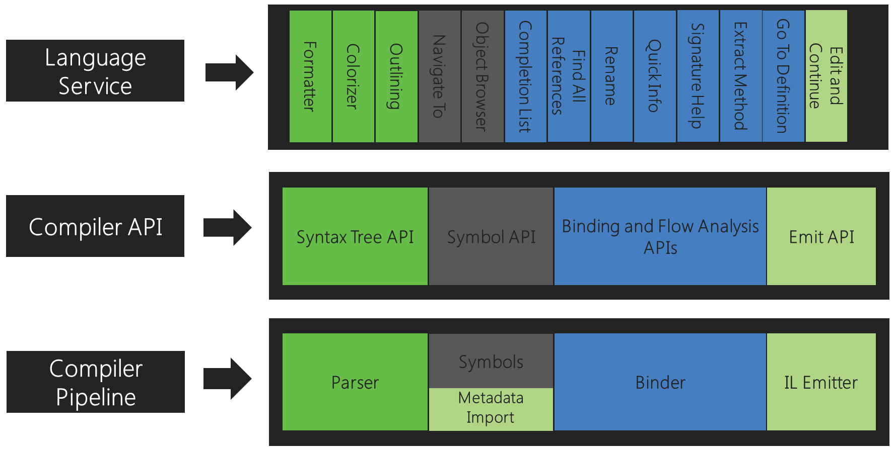
The .NET Compiler Platform SDK (Roslyn APIs) overview
Corresponding to each of those phases, the .NET Compiler Platform SDK exposes an object model that allows access to the information at that phase. The parsing phase exposes a syntax tree, the declaration phase exposes a hierarchical symbol table, the binding phase exposes the result of the compiler's semantic analysis, and the emit phase is an API that produces IL byte codes.

